Slide 1
Final Presentation
Spring 2017
VIP 5.0
Team: Ravi Kiran Agarthi
Shefali Nakum
Mentor: Mohsen Taheri
Instructor: Masoud Sadjadi
Francisco Ortega

Slide 2
Project definition
Problems with VIP 4.0
Downloading Excel from Admin Panel is giving an unnecessary popup
No Search box for each property of User’s information.
Not capturing the date when a student applies for a project and when a faculty proposes a project
Not capturing the date when a user creates a new account in VIP
Footer Design needs to be changed.
Not Capturing the date when a Student first logs into VIP.

Slide 3
Project definition

Slide 4
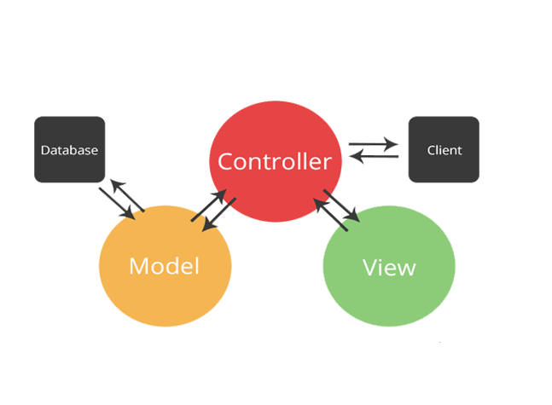

System Design: Architecture
Software:
MVC
Hardware:
Client-Server

Slide 5
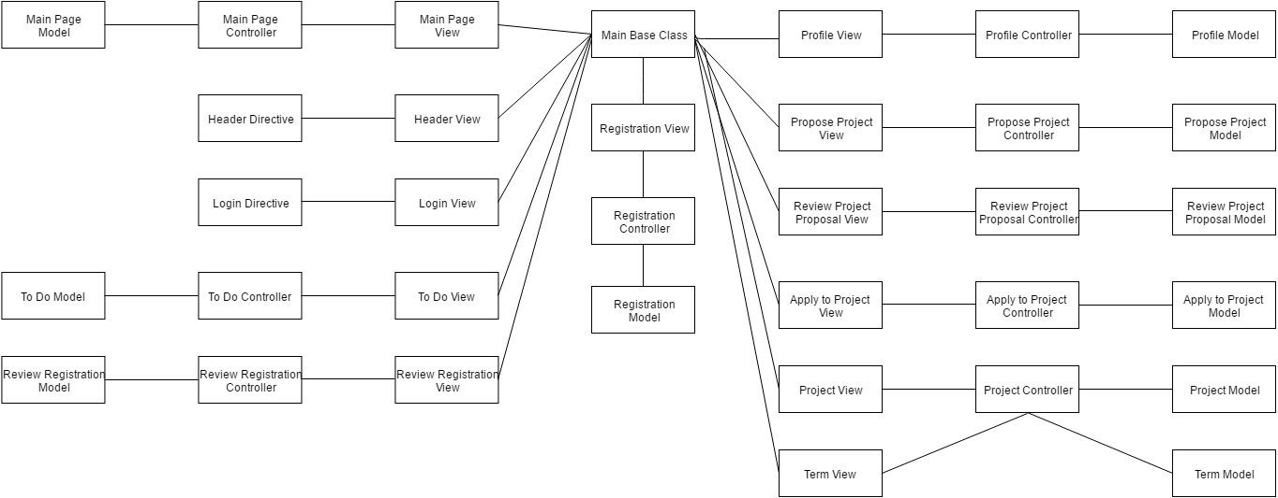
Minimal Class Diagram

Slide 6
User Stories
Handling Excel error
Adding search boxes for all user properties
Drop down for more filters
Reset all the filters.
Capturing Dates when Student applies to a Project
Capturing Dates when Faculty proposes a Project
Capturing Dates when a User creates a new account.

Slide 7
Admin Page
Before: There was no Search box available in order to search for a user based on a specific user property like emailid, project, semester etc.,
After: With new design, we can search for a user if we know a specific user property.

Slide 8
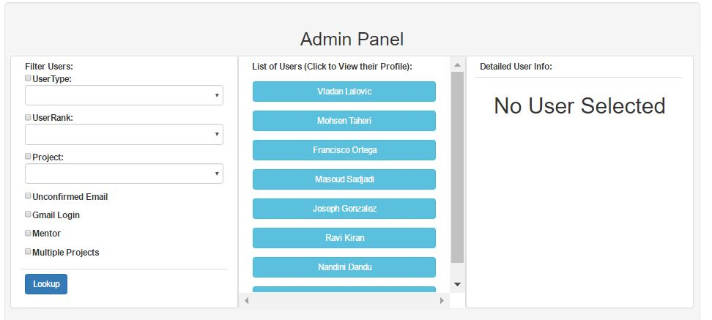
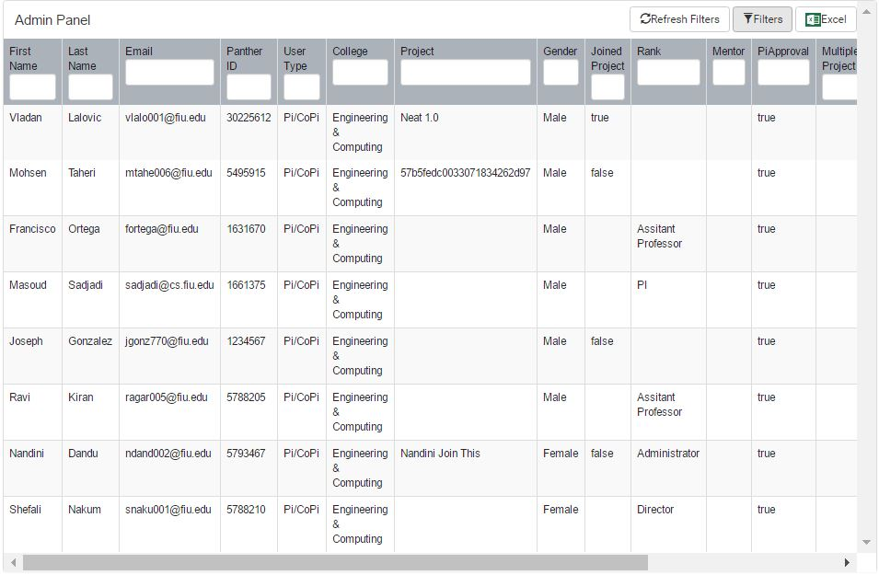
Before:
After:

Slide 9
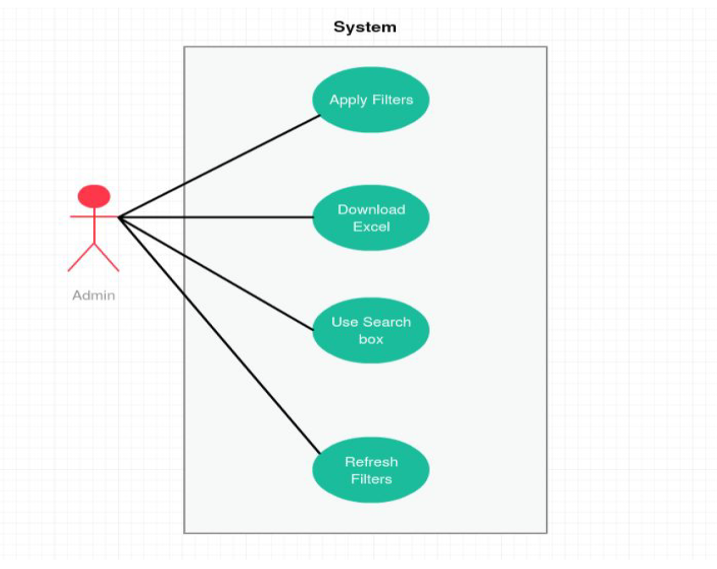
Use Case Diagram

Slide 10
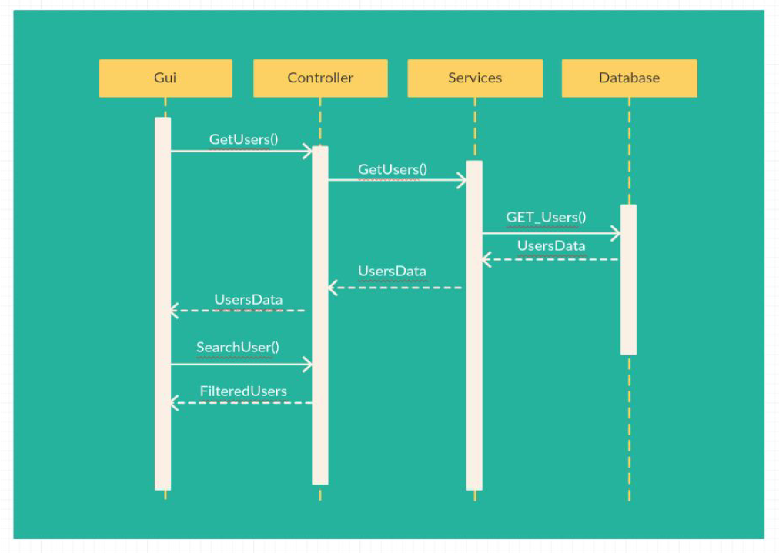
Sequence Diagram

Slide 11
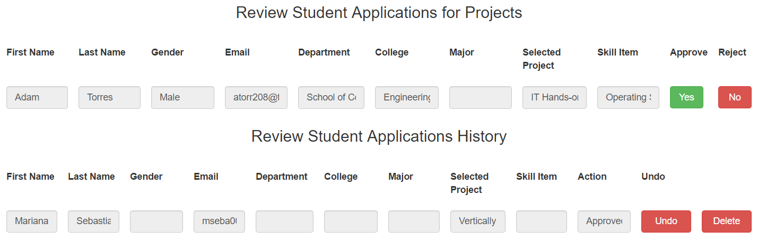
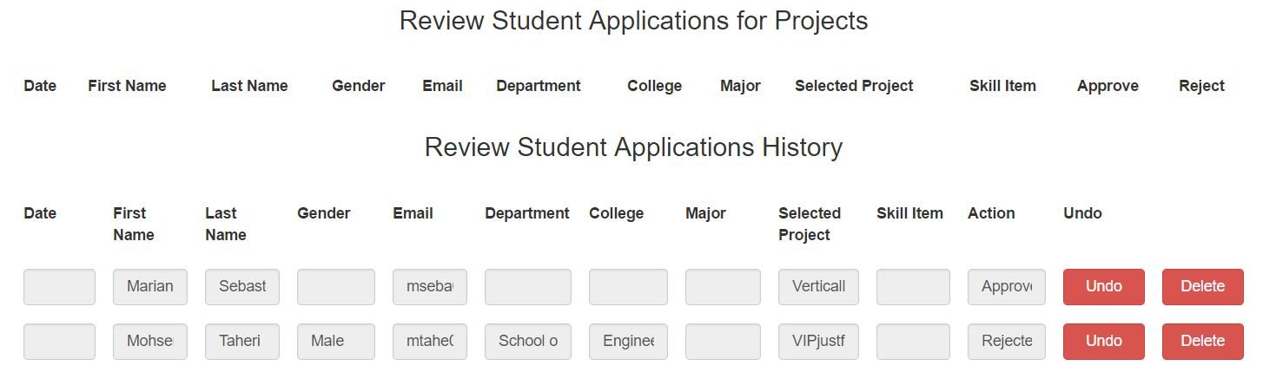
Review Student Application for Projects
Before:
After:

Slide 12
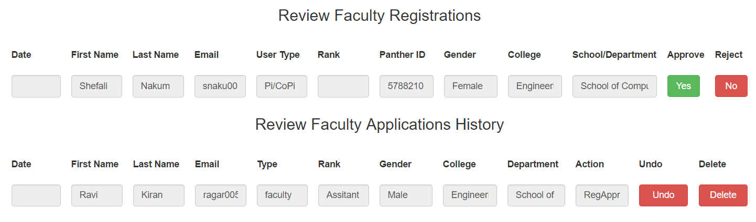
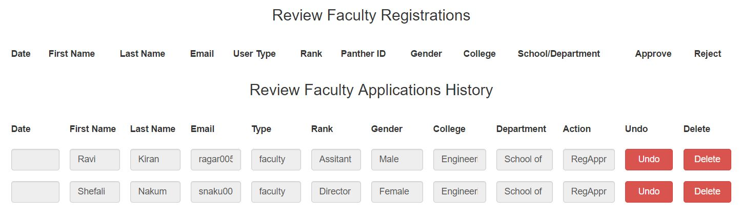
Review Faculty Registrations
Before:
After:

Slide 13
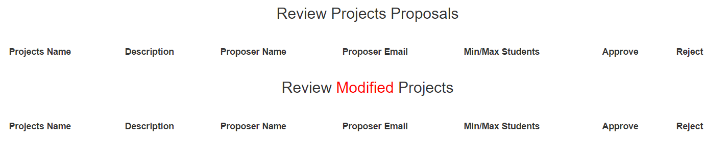
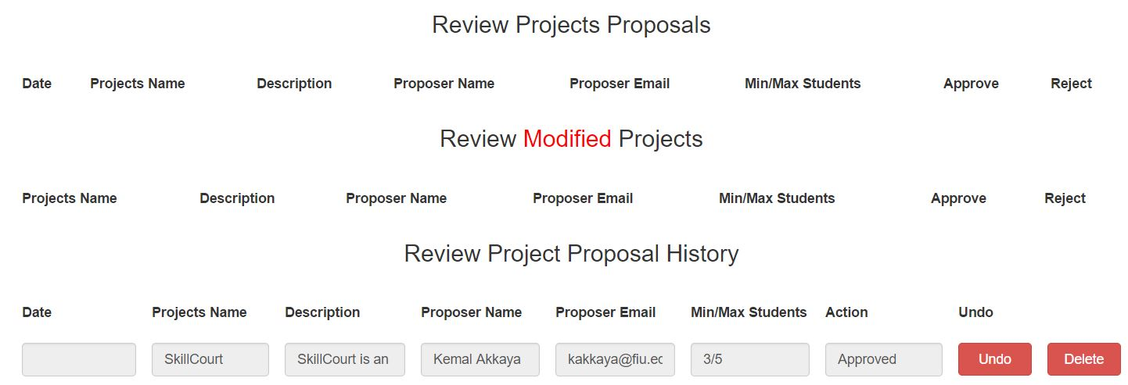
Review Project Proposals
Before:
After:

Slide 14
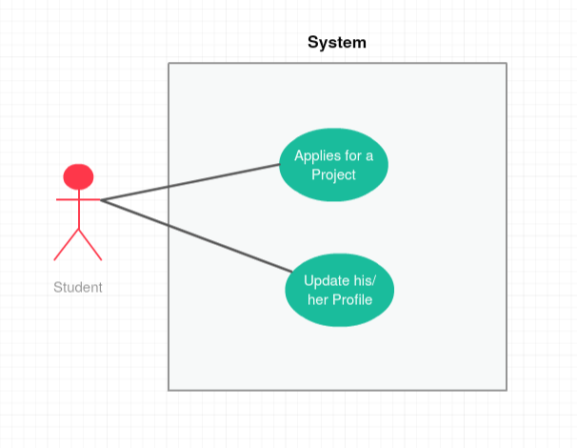
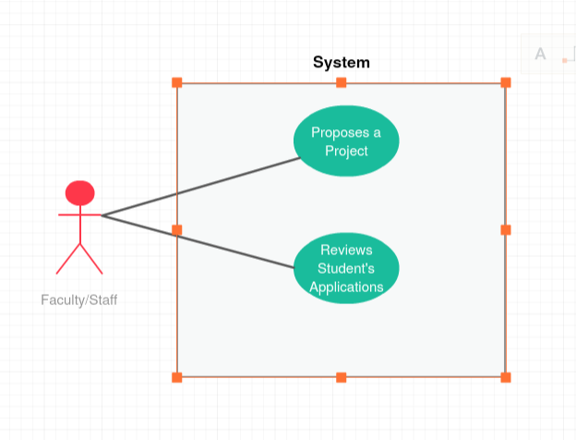
Use Case Diagram
Student
Faculty/Staff

Slide 15
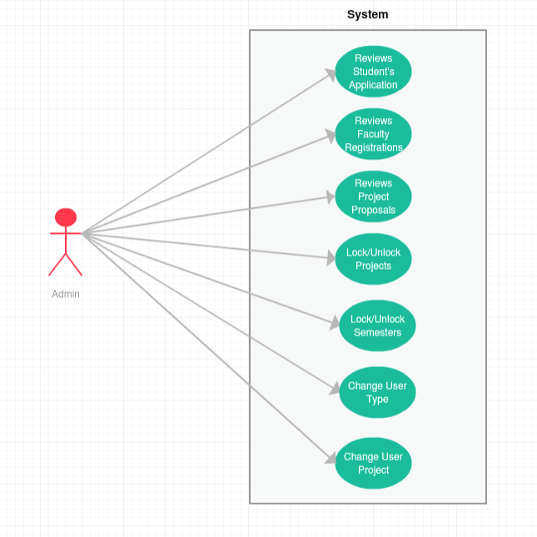
Admin

Slide 16
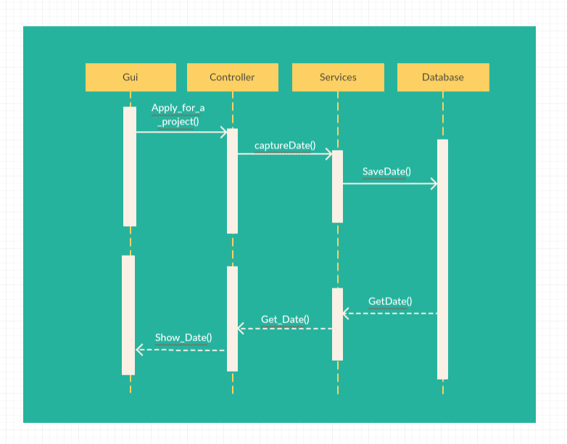
Sequence Diagram

Slide 17
SUMMARY
VIP 5.0 has a new design for Admin Panel which makes search more efficient.
VIP 5.0 still uses more filters option for Admin Panel but it will be a drop down and look and feel is changed
VIP 5.0 Admin Panel now has Refresh filter option with which Admin can refresh his search process.
VIP 5.0 now captures dates when Student Applies for a Project, Faculty Proposes a Project and when User creates a new account.
VIP 5.0 also captures the date when student first logs in for Admin purposes.

Slide 18




Summary
We can be contacted via email at snaku001@fiu.edu, ragar005@fiu.edu .
Questions?
Thank You!

